Slide 1


Slide 2


Competitive Programming Club
Student Club by
Department of Information and Communication Technology
Faculty of Engineering and Technology
Marwadi University
Club Mentor
Prof. Nishith Kotak
(Location: MA157)
nishith.kotak@marwadieducation.edu.in
For joining CP club register in MU club registration Portal.

Slide 3
Club Objective
The competitive programming club has been established to create the awareness about the importance of programming and to explore the areas where programming is used.
Students will be trained in different aspects like learning to develop logic, building optimized algorithms, prepare for placements, exploring the concepts taught in class even further.
Student does not need to be an expert in any field, they can start from wherever they are and keep improving. .

Slide 4
Club Outcomes
To provide platform to the students and community to learn, shape, and network, bringing them together with industry experts and allowing them to engage in healthy competition.
Swift exchange of ideas, information, and knowledge pertaining to Programming among club members that equips the students for the professional skills and tools.
Ensure that every student is continuously learning and growing in the domain of programming and is able to apply the skills on online coding contests.
To provide hands-on experience through, discussion, events, and guest speakers in the area of programming.
To help students to grasp the different concepts of programming and is able to use it wherever necessary without any difficulty.

Slide 5
Club Activities (1/2)
Fundamentals of programming
Fundamentals of Object Oriented Programming
Pattern Programming
How to deal with different types of errors
Introduction to Git and Github
Fastest finger first type quiz
Code Tracing
Different types of coding and algorithm paradigms
Coding using MVC Architecture
Role-playing data structure operations activity
How to build Chrome Extensions
Solving data structure problems

Slide 6
Club Activities (2/2)
Relay Coding activity
Google Kickstart and other national/international level code participation and building logic
How to create backend restful APIs. And many more…
NOTE: At least 10 activities will be carried out based on the targeted students and their current level of learning of curriculum.

Slide 7
Benefits to the Members
Workshops and Hands-On training Sessions
Mentoring
Hackathon/Competition Supports
Interactions with the experts
Industry Visits
Placement Support to the Members
And many more…

Slide 8
Skills to Master
Fundamentals of programming
Logic Designing
Object-Oriented Programming
Data Structures
Algorithms
Relay Coding
Code Debugging
Different types of programming paradigms
Adapt to different languages easily
Reading documentation
And Many More………

Slide 9
Club Activity Rules (1/2)
There should be plan-out of at least 12 hands-on training sessions with 4+ expert talk and hackathon event within the club as well as throughout the university, in a year.
The club should conduct the assessments, training activities in-consultation with the industries.
The club should engage and coordinate with the industries to design the training sessions, assessments, design problem statements based on the industrial requirements, etc. to give the students an exposure to the industrial requirements and make them placement-ready.
There should be planned expert-talks from alumni, industries or leading academicians that can motivate the students.
Regular engagement of the students should be done by the core committee of the club.
The role of the pseudo committee will be to support the core committee in the engagement process of the events planned for the students.

Slide 10
Club Activity Rules (2/2)
The annual membership fee of the student in a club is Rs. 100, which needs to be utilized for the club activities only, and the proof needs to be transparent among the participants.
The positions will be on the rolling basis, which will be done every six months depending on the sincerity, dedication and work ethics of the candidate.
The club should extend their hands in guiding the students and motivate them in taking parts in different competitions and fellowship exams.
The Running Trophy will be given to the “best performer” from each club, every month.
Issuing the Digital Badge, Certificate and physical Sticker of the best performer will be given to the student.
Winner from the major competition may be awarded with the trophies.
Digital Certificate of the participation in Data Science Club, will be issued to each of the members based on their regularity in the activities.
The final decision lies in the hands of Faculty Coordinator, Overall Club coordinator and Head of Department.

Slide 11
Skills to Master
Fundamentals of programming
Logic Designing
Object-Oriented Programming
Data Structures
Algorithms
Relay Coding
Code Debugging
Different types of programming paradigms
Adapt to different languages easily
Reading documentation
And Many More………

Slide 12
Club’s Core Committee Members
Convenor - Abhay Nathwani
Dy. Convenor - Aryan Langhanoja
General Secretary - Vivek Chavda
Event Coordinator - Kaushal Parmar
TechLead - Payal Makwana
Content Manager - Shivkumar Paun

Slide 13
Club’s Pseudo Core Committee Members
Convenor - Keshvi Santoki
Dy. Convenor - Ayush Vora
Event Coordinator - Ronit Motivaras
Club Member - Akshat Shah
Club Member - Ruhaan Pathan
Club Member - Ansh Raythatha
Club Member - Heer Mehta
Club Member - Dhwani Desai
Club Member - Diya Kalariya
Club Member - Manav Mandaliya
Club Member - Naman Jain
Club Member - Bhumi Solanki

Slide 14
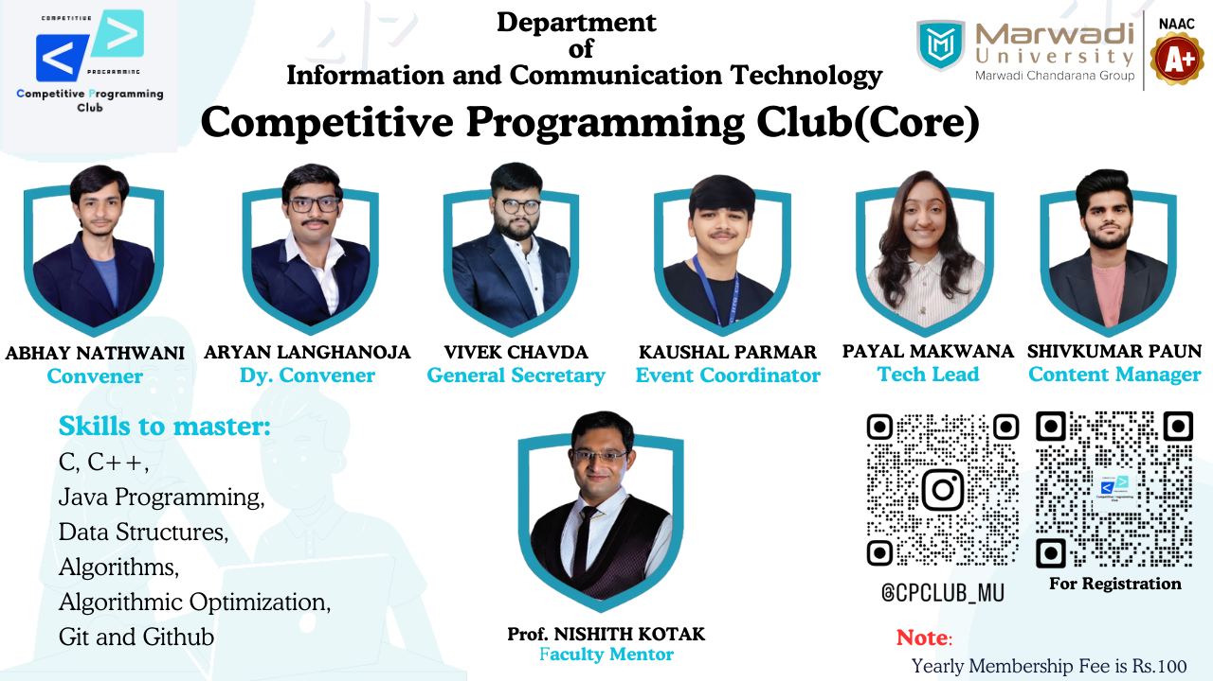

Slide 15
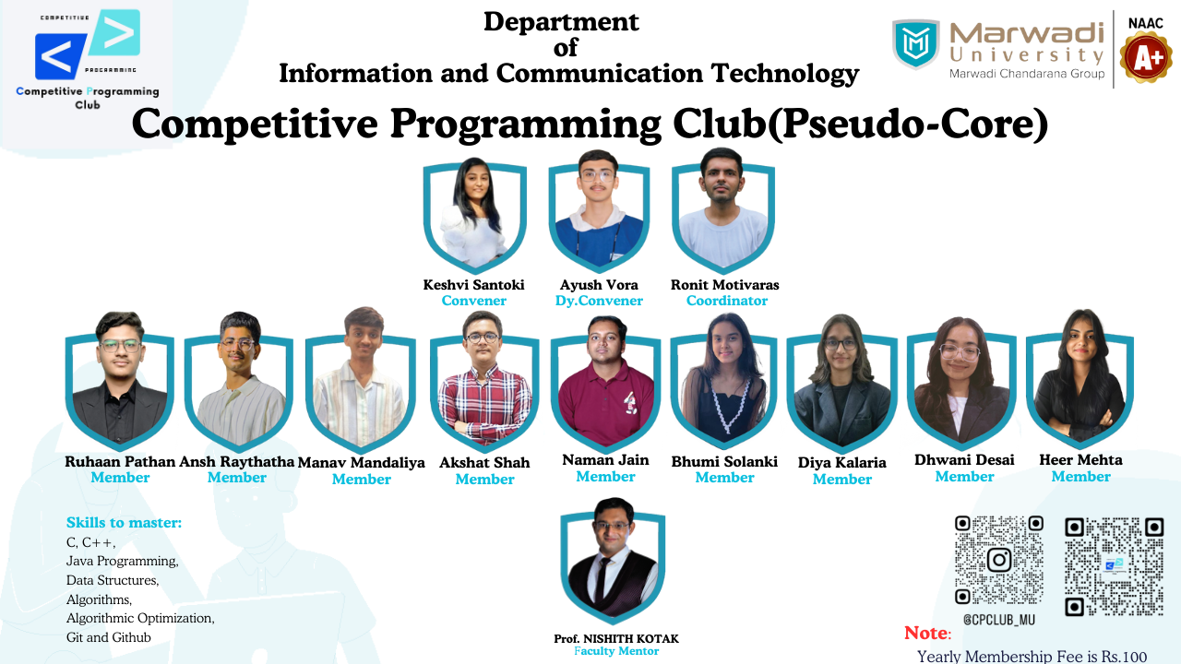

Slide 16


